Slide 1
Statistics Fundamentals
Patrick Mathias

Slide 2
Disclosure of Relevant Financial Relationships
The faculty, committee members, and staff who are in position to control the content of this activity are required to disclose to MSACL and to learners any financial relationships that have occurred within the last 24 months with ineligible companies whose primary business is producing, marketing, selling, re-selling, or distributing healthcare products used by or on patients. MSACL has reviewed the disclosures and mitigated all relevant financial relationships.
You can view the financial disclosures of any Steering / Scientific Committee Member or Podium Presenters (except for Industry Workshops, which do not qualify for CME credit) on the MSACL website directly underneath the person’s name. Click “Review Relevant Financial Disclosures”.
MSACL staff associated with the development of content for this activity report no relevant financial relationships.
Notes:
This slide must be included in your deck WITHOUT MODIFICATION. You will declare your Relevant Financial Relationships on the following slide.

Slide 3
Relevant Financial Relationships
Company | Relationship | Ended?
None

Slide 4
Lesson Objectives
Understand the fundamental statistical concepts used in laboratory medicine, including measures of central tendency, variability, and probability distributions
Critically evaluate the validity and limitations of basic statistical inference methods (e.g., regression models, hypothesis testing, confidence intervals) in various laboratory scenarios
Apply statistical principles to real-world laboratory scenarios to improve laboratory quality, interpret results accurately, and make evidence-based decisions.
Notes:
In this first session our goal is to develop some familiarity with the R programming language.
We will also discuss the important role of reproducible data analysis and how R can help us with this.

Slide 5
Concept review

Slide 6



Summary Statistics
Mean (Average):
Sum of all values divided by the number of values
Sensitive to extreme values (outliers)
Median:
Middle value when data is ordered
Less affected by outliers than the mean
Standard Deviation (SD):
Measures the spread or dispersion of data around the mean
Higher SD = more variability
Z-Score:
Standardized value indicating how many SDs a point is from the mean
Helps compare values across different distributions

Slide 7
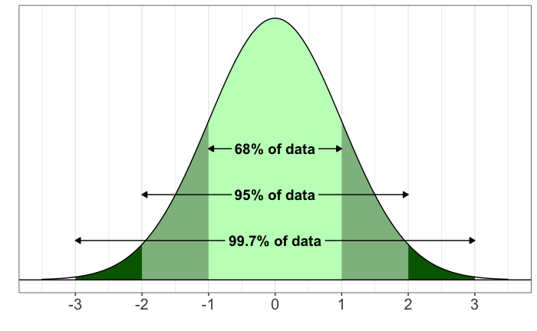
The Normal Distribution
Standard deviations from the mean
ASpiegler, CC BY-SA 4.0 <https://creativecommons.org/licenses/by-sa/4.0>, via Wikimedia Commons
Notes:
One of the most important and commonly observed distributions in biology is the normal distribution, shown in this figure. A normal distribution has a symmetrical, bell shape.

Slide 8
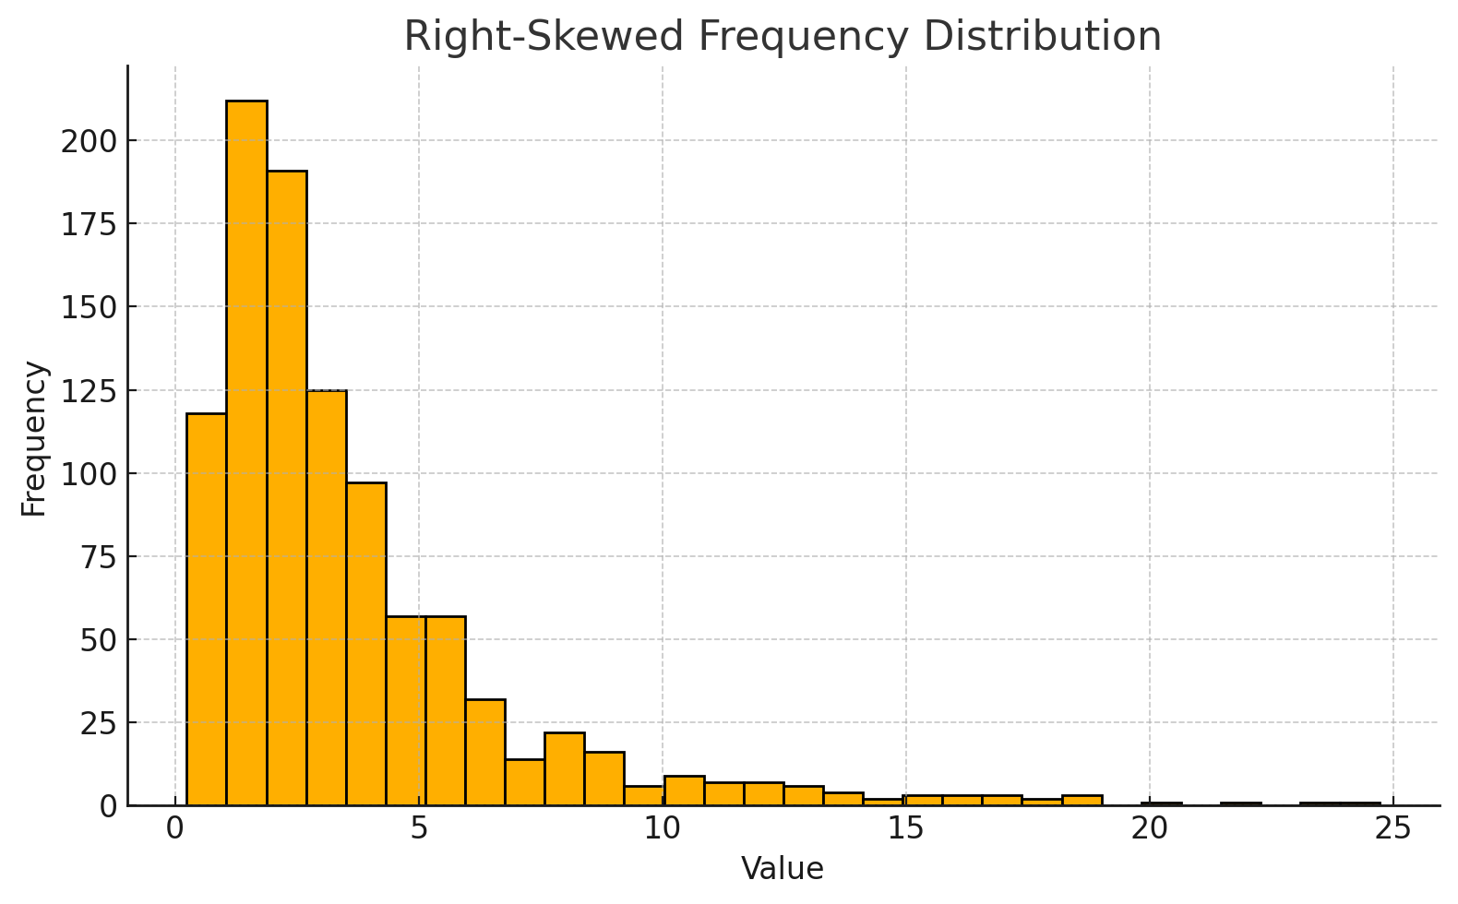
Visualizing Distributions
If a variable can have many possible values, we can plot the observed values as a frequency distribution. This simulated data set shows a right skew in the distribution of values.

Slide 9
Features of the Normal Distribution
Very common distribution in biology and medicine
If a distribution shows skewing to the right, transformation to a normal distribution can often be accomplished by log transformation
The normal distribution is often the basis for establishing reference intervals for lab tests
central 95% of the distribution is often considered to be the reference interval
The mean +/- 2 standard deviations includes approximately 95% of all observations
The mean +/- 3 standard deviations includes approximately 99.7% of all observations

Slide 10
Exercise 1
Open the lesson_3_exercises.pdf file in the exercises folder
Complete exercise 1 as an orientation to the chemistry data set

Slide 11
Statistical tests
Notes:
Once we know how to do basic manipulations of a dataset, we can use this to run common statistical tests.

Slide 12
Statistical tests
We are often interested in whether observed values are meaningfully different either between groups, or from a fixed value. To do this we use statistical tests.
There are a wide variety of tests, but most operate in the same way.
1) You assume the shape (“distribution”) of the data if there is no effect – this is called the null hypothesis 2) Assuming the null hypothesis is true, you estimate the probability of seeing an effect as big as what your data shows by random chance.

Slide 13
Statistical tests
Imagine you have a six-sided die, and roll it 10 times, getting: 1, 5, 1, 1, 6, 3, 1, 1, 1, 2 That’s a lot of 1’s! Maybe the die is loaded… If we wanted to test whether the die is fair, we: 1) Assume the die is fair – that each outcome is equally likely
2) With this assumption, we estimate the probability of getting at least 6x 1’s from 10 rolls.

Slide 14
Statistical tests
From a fair die, the probability of rolling at least 6x 1’s in 10 throws is 0.24% (1 in 400). That’s pretty unlikely. This means our initial assumption (‘the die is fair’) is probably wrong!
The p-value from a statistical test is the probability of a result as extreme as the data occurring due to chance, given the null hypothesis. This is the 0.24% above.
Often we use the (somewhat arbitrary) threshold of p < 0.05 (5%).
Note, the p-value is NOT the probability our hypothesis is correct.

Slide 15
Statistical tests
When analyzing data, there are two questions we are often interested in:
1) Does a mean differ between two groups?
2) Does an event rate differ between two groups?
For most datasets these questions can be evaluated with 1) a t-test, and 2) a chi-squared test

Slide 16
Student’s t-test
Notes:
Once we know how to do basic manipulations of a dataset, we can use this to run common statistical tests.

Slide 17
Student’s t-test
To test differences in means, we often use a t-test. This test assumes:
1) The data points are independent
2) The data are normally distributed (bell-curve shaped)
3) The variance of the two groups is similar
There are two types of t-test:
1-sample: Test whether a mean differs from a given value
2-sample: Test whether two groups have different means

Slide 18
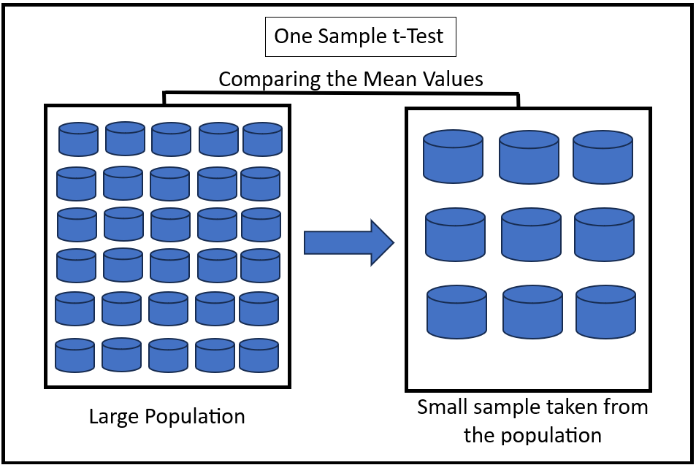
One-sample t-test
https://en.wikipedia.org/wiki/Student%27s_t-test

Slide 19
One-sample t-test
If we wanted to test whether total cholesterol levels in outpatients within our chemistry data set were different from the US adult average (~190ng/mL), we’d use a one-sample t-test.
Given our chemistry data set, which includes results for a large number of tests in a broad population, what specific steps do we need to complete to analyze the data set?

Slide 20
One-sample t-test
Create a subset of the broader data set with only cholesterol results
Further subset the data to include only outpatient results
Perform a t-test that compares these specific results to a population mean value of 190 ng/mL

Slide 21
Exercise 2
We will complete exercise 2 in the lesson 3 exercises file together

Slide 22
One-sample t-test in R
If we wanted to test whether total cholesterol levels in outpatients within our chemistry data set were different from the US adult average (~190ng/mL), we’d use a 1-sample t-test.
Filter down to the given test and limit to outpatients
Run the t-test
chol_subset <- filter(chem, test == ‘cholesterol’, pat_type == ‘outpatient’)

Slide 23
One-sample t-test in R
Filter down to the given test and limit to outpatients
Run the t-test
dataframe
variable
presumed value
t_test(chol_subset, response = value, mu = 190)

Slide 24

One-sample t-test
chol_subset <- filter(chem, test == ‘cholesterol’, pat_type == ‘outpatient’)
t_test(chol_subset, response = value, mu = 190)
p-value
t-statistic

Slide 25
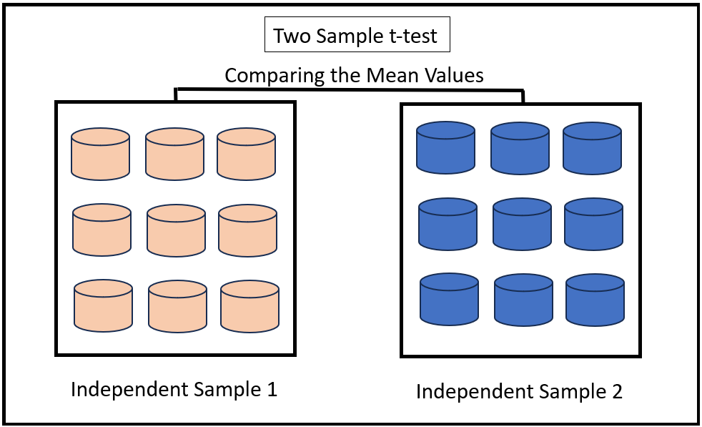
2-sample t-test
https://en.wikipedia.org/wiki/Student%27s_t-test

Slide 26
Two-sample t-test
If we wanted to test whether females had lower total iron than males within our chemistry data set, we’d use a two-sample t-test.
Given our chemistry data set, which includes results for a large number of tests in a broad population, what specific steps do we need to complete to analyze the data set?

Slide 27
Two-sample t-test
Create a subset of the broader data set with only iron results
Sort the data so female and male results can be easily separated from each other
Perform a two-sample t-test that compares the data from these two groups

Slide 28
Exercise 3
Complete exercise 3 in the lesson 3 exercises file on your own, with minor modifications from exercise 2

Slide 29
Two-sample t-test in R
If we wanted to know whether women had lower iron levels than men, the steps would be:
Filter down to the given test and cohort
Run a 2-sided t-test
iron_subset <- filter(chem, test == ‘iron’, pat_type == ‘outpatient’)

Slide 30
Two-sample t-test
Filter down to the given test and cohort
Run a 2-sided t-test
outcome variable
dataframe
group value
t_test(iron_subset, response = value, explanatory = gender,
order = c(“Male”, “Female”)
male values are the reference
For this difference in means calculation, subtract female values from male values

Slide 31
2-sample t-test in R
iron_subset <- filter(chem, test == ‘iron’, pat_type == ‘outpatient’)
t_test(iron_subset, response = value, explanatory = gender,
order = c(“Male”, “Female”)

Slide 32
Chi-squared test
Notes:
Once we know how to do basic manipulations of a dataset, we can use this to run common statistical tests.

Slide 33
Chi-squared test
To test for differences in event rates, we often use a chi-squared test. This test assumes:
1) The data points are independent
2) We expect at least 5 occurrences of each event for each sub-group
The most common type of chi-squared tests whether event rates are similar for multiple groups. There are other variants for different scenarios.

Slide 34
Chi-squared test
Lets say we want to know if two clinics order a test at the same rate. We have the following data:
To evaluate this, we need to know what the average rate of ordering is: avg rate = (51 + 81)/(103 + 209 + 51 + 81) = 29.7%
 | Test not ordered | Test ordered
Clinic 1 | 103 | 51
Clinic 2 | 209 | 81

Slide 35
Chi-squared test
If on average the test is ordered for 29.7% of visits. Then for clinic 1, which has 154 total visits we’d expect 154*0.703: 108.2 tests not ordered, and 154*0.297: 45.8 tests ordered Clinical 2 has 290 total visits, so we’d expect 86.1 tests ordered, 203.9 tests not ordered
A chi-squared test checks whether this table is meaningfully different to the observed table
 | Test not ordered (Expected) | Test ordered (Expected)
Clinic 1 | 108.2 | 45.8
Clinic 2 | 203.9 | 86.1

Slide 36
Chi-squared test
To run chi-squared tests in R, we have three steps
Filter down to the given test and groups
Generate the binary outcome variable
Run the test
To illustrate this, lets check whether male + female outpatients have different rates of low iron (<32)

Slide 37
Chi-squared test
To run chi-squared tests in R, we have three steps
Filter down to the given test and groups
Generate the binary outcome variable
Run the test
iron_subset <- filter(chem, test == ‘iron’, pat_type == ‘outpatient’)

Slide 38
Chi-squared test
To run chi-squared tests in R, we have three steps
Filter down to the given test and groups
Generate the binary outcome variable
Run the test
iron_subset <- iron_subset |>
mutate(iron_binary = (value < 32))

Slide 39
Chi-squared test
To run chi-squared tests in R, we have three steps
Filter down to the given test and groups
Generate the binary outcome variable
Run the test
outcome variable
dataframe
group value
chisq_test(iron_subset, iron_binary ~ gender)

Slide 40
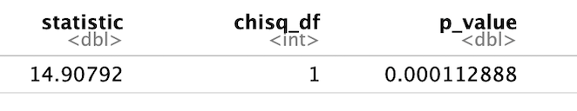
Chi-squared test in R
iron_subset <- filter(chem, test == ‘iron’, pat_type == ‘outpatient’)
iron_subset <- iron_subset |> mutate(iron_binary = (value < 32))
chisq_test(iron_subset, iron_binary ~ gender)

Slide 41
Regression Concepts

Slide 42

Correlation Coefficients
Correlation Coefficient (r):
Strength & direction of the linear relationship between two continuous variables
Pearson correlation coefficient (r) assumes approximately bivariate normal distribution
Values range from –1 to +1
r= +1: perfect positive linear correlation
r= −1: perfect negative linear correlation
r= 0 : no linear correlation

Slide 43
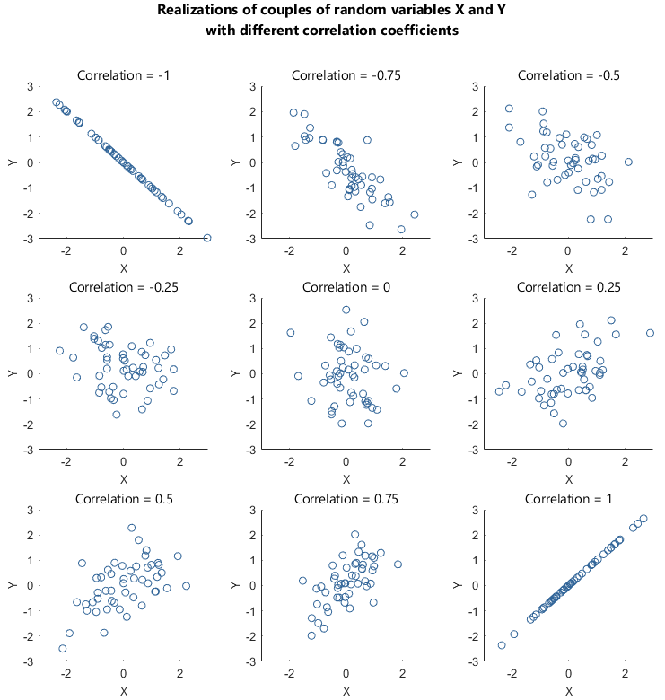
https://www.statlect.com/fundamentals-of-probability/linear-correlation

Slide 44
Correlation Coefficients
In Linear Regression:
Correlation reflects how well the independent variable (X) predicts the dependent variable (Y)
Stronger |r| = data points lie closer to the regression line
Coefficient of Determination (R²):
R² = r² in simple linear regression
Represents the proportion of variance in Y explained by X
Example: R²=0.64 → 64% of variation in Y is explained by X
Important Notes:
Correlation does not imply causation
Outliers can strongly affect r and R²

Slide 45
What Does the Correlation Coefficient Mean?
A correlation coefficient can be interpreted as how much one variable changes as the other variable changes. It is useful to think of these in standard deviations. How many SDs does one variable change with a 1 SD change in the other variable?
•r measures the strength of the relationship between methods, not the level of agreement
•e.g., x=data points; y=x gives correlation coefficient of 1
•But x=data points, z=x+25 gives correlation coefficient of 1
•If the points lie on a straight line with slope ≠ 0, there will be perfect correlation (positive or negative)
•The wider the range of values, the stronger the correlation can be
•May be confusion about independent and dependent variables, and which way to plot the graph (the r value is the same either way)
•Measurements of the same measurand should be strongly related!

Slide 46
Exercise 4
Complete the correlation exercise in the lesson_3_exercises pdf.

Slide 47

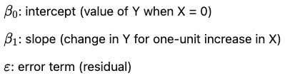
Linear Regression
Purpose:
Model relationship between an independent variable (X) and a dependent variable (Y)
Predict Y based on X
Key Assumptions:
Linearity: relationship between X and Y is linear
Independence: observations are independent
Homoscedasticity: constant variance of residuals
Normality: residuals are normally distributed
Notes:
Homoscedasticity failure would result in poor predictions, potential wrong conclusions (in hypothesis testing), wide confidence intervals

Slide 48
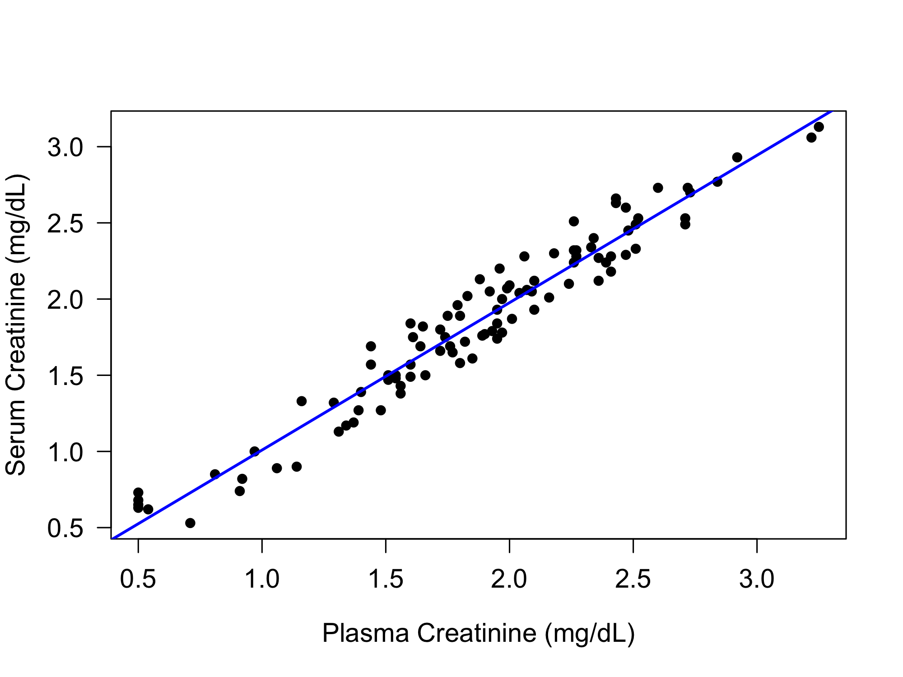
Linear Regression Example
y= 0.04 + 0.97x
Method Comparison
Creatinine dataset
Notes:
mcr dataset

Slide 49

Checking Model Assumptions
Linearity: relationship between X and Y is linear
Independence: observations are independent
Homoscedasticity: constant variance of residuals
Normality: residuals are normally distributed
Residual
Difference between model and actual
Each point has a residual
Can be zero, positive. or negative
Notes:
Linearity: visual or stats tests
Independence: no repeats on the same sample or patient

Slide 50
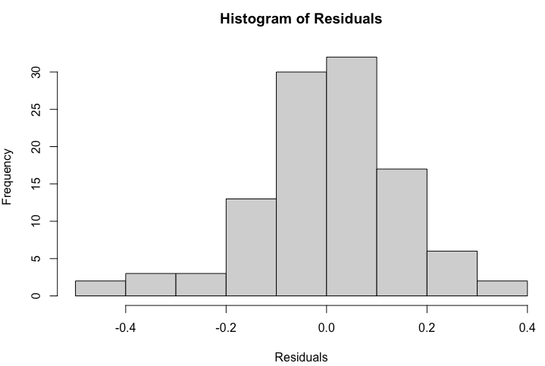
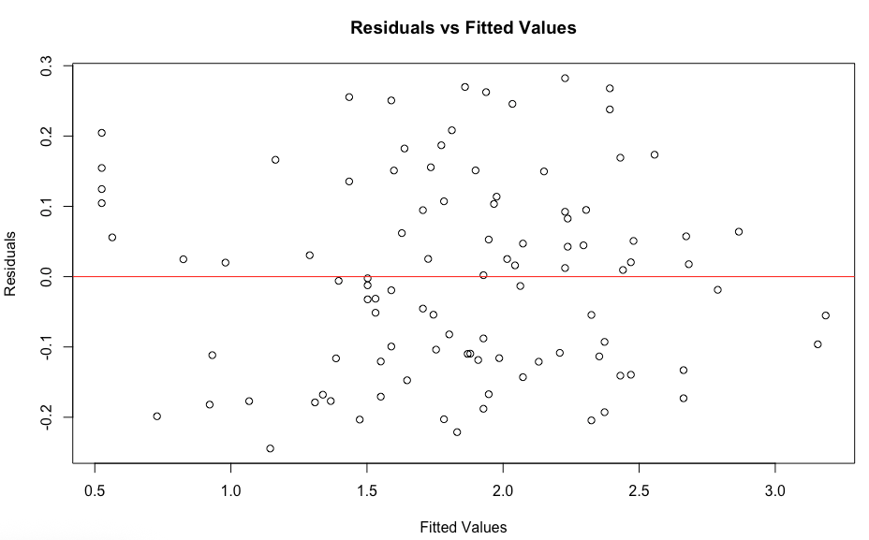
Checking Model Assumptions
Linearity: relationship between X and Y is linear
Independence: observations are independent
Homoscedasticity: constant variance of residuals
Normality: residuals are normally distributed

Slide 51
Making Predictions
When we know the mathematical relationship between two variables (x and y) from observed data, we can make a prediction about the value of y for any value of x. This is a key concept in data science.
Recall that for a linear regression model, Y = β₀ + β₁X + ε where this is the equation of a straight line with intercept of β₀ and slope of β₁. Here ε indicates the error term (the difference between an observed value and the regression line).
If we have a new observation, let’s call it x_{n}, we can predict y_{n} by applying the equation above, and assuming that ε =0.
We should limit predictions to the range of values of x that were observed in the regression model because the relationship between y and x may not be beyond the interval of the observed data.

Slide 52
Exercise 5
Complete the regression exercise in the lesson_3_exercises pdf.

Slide 53
Sometimes ordinary least squares is not what the doctor has ordered…
Default regression analysis in Excel = ordinary least square (OLS)
Mechanics: Fits a line by minimizing vertical distances between observed y-points and line.
Assumptions:
All error in y-axis variable, x measured without error
Homoscedastic errors (constant variance)
Relationship is linear

Slide 54
Sometimes ordinary least squares is not what the doctor has ordered…
Issue in method comparison:
Both methods (x and y) have imprecision → slope estimate biased toward zero (attenuation bias)
High (R^2) from OLS doesn’t mean good agreement in method comparison — often misleading if slope < 1 and intercept ≠ 0
Good for: Prediction when x truly measured without error (e.g., calibrator value).

Slide 55
Deming regression is often more appropriate for comparisons expected to have similar error
Mechanics: Fits a line minimizing orthogonal distances to the line (accounts for error in both axes)
Assumptions:
Linear relationship
Normally distributed measurement error in both variables
Variance ratio of errors in x and y is known (often assumed = 1 if same units/precision)

Slide 56
Deming regression is often more appropriate for comparisons expected to have similar error
Strength in method comparison:
Removes attenuation bias
More accurate slope/intercept estimates for comparing two analytic methods
Widely recommended in CLSI EP09 guidelines for method comparison
Limitation:
Sensitive to outliers
Requires variance ratio — if poorly estimated, line can be misfit
Good for: Two methods with similar distributions/error patterns, and variance ratio can be estimated

Slide 57
Considerations for more advanced regression
Deming regression is not available within the default analysis tools in Excel
Readily available in mcr package in R
Passing Bablok is another regression method that is non-parametric
Robust to outliers
Also not available in Excel

Slide 58
Lesson Objectives
Understand the fundamental statistical concepts used in laboratory medicine, including measures of central tendency, variability, and probability distributions
Critically evaluate the validity and limitations of basic statistical inference methods (e.g., regression models, hypothesis testing, confidence intervals) in various laboratory scenarios
Apply statistical principles to real-world laboratory scenarios to improve laboratory quality, interpret results accurately, and make evidence-based decisions.
Notes:
In this first session our goal is to develop some familiarity with the R programming language.
We will also discuss the important role of reproducible data analysis and how R can help us with this.

Slide 59
References & Acknowledgements
Brody Foy for t-test content & exercises
Tony Killeen & Chris McCudden for correlation and regression content & exercises adapted from ADLM Data Science Certificate program

